Slide 1
AngularJS + Asp.Net Web Api, Signalr, EF6 + Redis：前後端整合篇
開發技巧實戰系列(5/6) - Web 前後端整合
講師: 郭二文 (erhwenkuo@gmail.com)
Notes:
開發技巧實戰
1. AngularJS入門篇
2. AngularJS + HighChart：完美網頁圖表整合篇
3. AngularJS + Asp.Net WebApi 2 +SignalR：前後端整合篇
4. AngularJS + Asp.Net WebApi 2+ SignalR + Entity Framework 6 (ORM)：前後端整合篇
5. AngularJS + Asp.Net WebApi 2+ SignalR +Entity Framework 6 (ORM) + Redis (Nosql)：前後端整合篇
6. AngularJS + Asp.Net WebApi 2+ SignalR +Entity Framework 6 (ORM) + Redis (Nosql) + Elasticsearch (全文檢索)：前後端整合篇

Slide 2
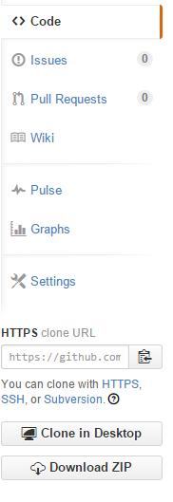
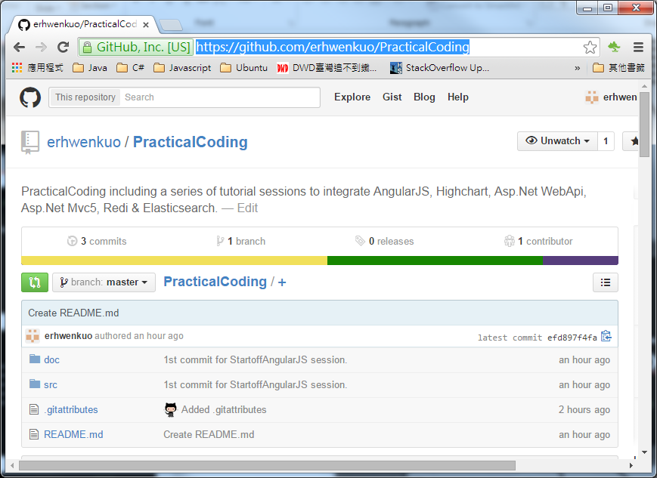

Document, Source code & Training Video (5/6)
https://github.com/erhwenkuo/PracticalCoding

Slide 3


Previous Training Session Document, Source code & Training Video (4/6)
https://www.youtube.com/watch?v=AjEG65JTKKU
http://www.slideshare.net/erhwenkuo/04-integrate-entityframework
Notes:
本章節的內容會延續前一個Session的知識與內容, 如果對前一章節不熟悉的話, 可以在Yoube或Slideshare找到文件與教學錄影

Slide 4
Agenda
StackOverflow Architecture
Redis Overview
Developing Asp.Net C# with Redis
Highchart , AngularJS ,Web API2 , SignalR2 , EF6 + Redis Integration

Slide 5

stackoverflow Architecture

Slide 6
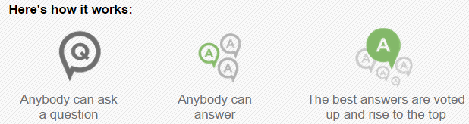
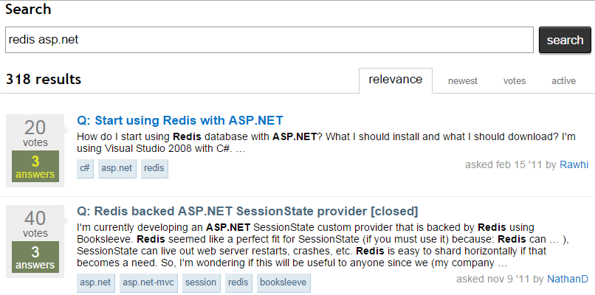
“stackoverflow.com” Introduction
Stack Overflow is a question and answer web site for professional and enthusiast programmers
It's 100% free, no registration required
Rank#60 World-wide most popular web-site

Slide 7


Some Number of stackoverflow
Ranked 54th for web-site traffic in the world
4 million users
40 million answers
560 million pageviews a month
But…. Only 25 servers used

Slide 8
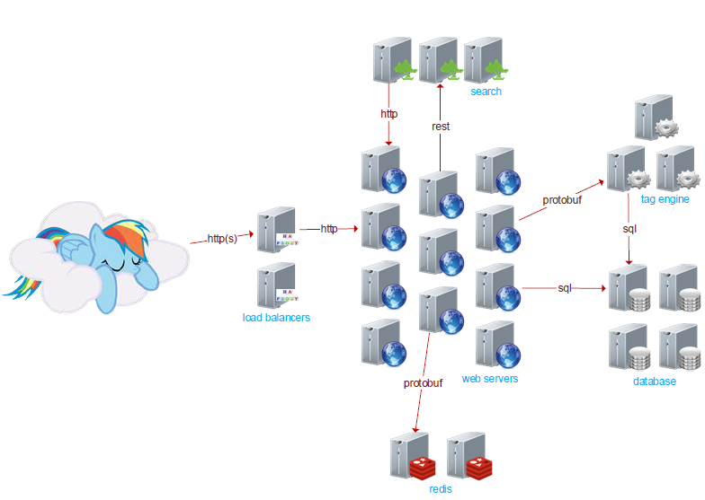
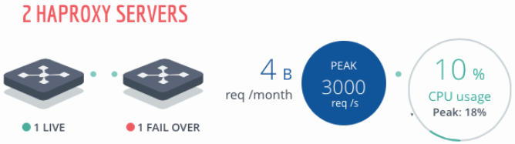
Architecture of stackoverflow
2 load balancers, 1 active, using HAProxy
HAProxy is a free, very fast and reliable solution offering high availability, load balancing, and proxying for TCP and HTTP-based applications.
HAProxy is Open Source

Slide 9
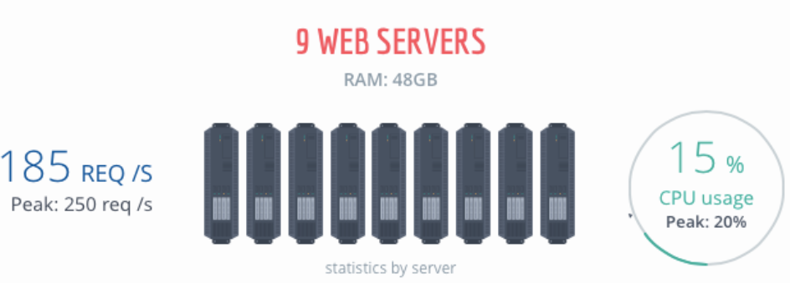
Architecture of stackoverflow
9 web servers, using Microsoft IIS

Slide 10
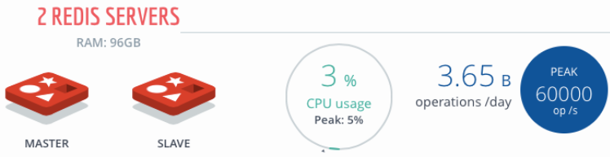
Architecture of stackoverflow
2 machines for distributed cache and messaging using Redis

Slide 11
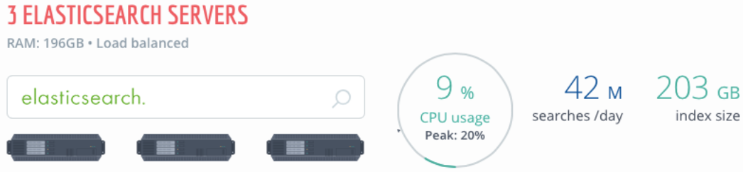
Architecture of stackoverflow
3 machines doing search with ElasticSearch

Slide 12
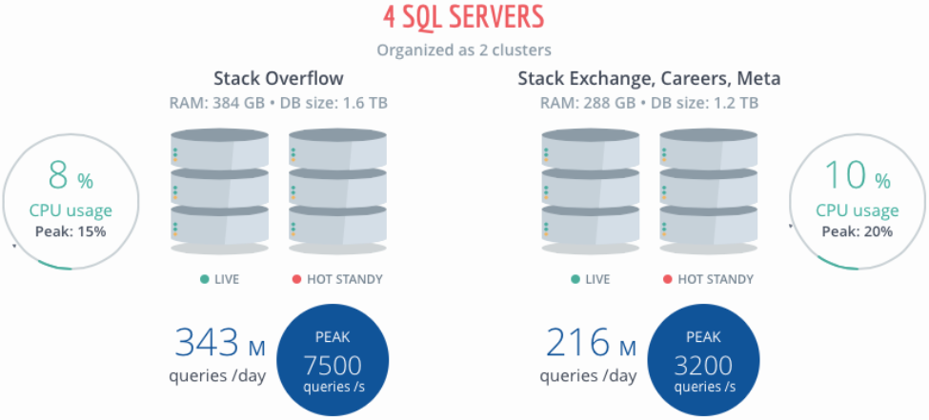
Architecture of stackoverflow
4 active database nodes, using MS SQL

Slide 13
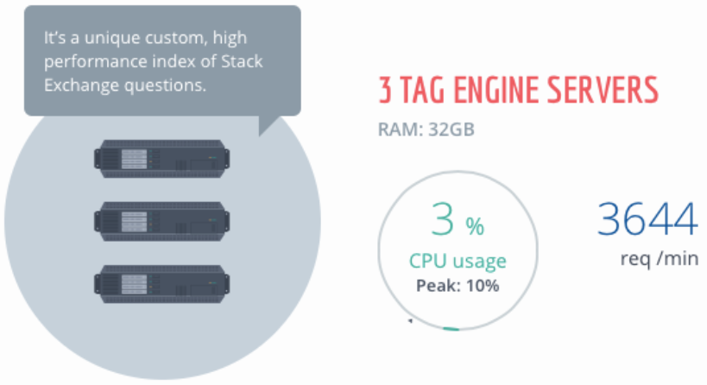
Architecture of stackoverflow
3 application servers implementing the tag engine, anything searching by tag hits

Slide 14
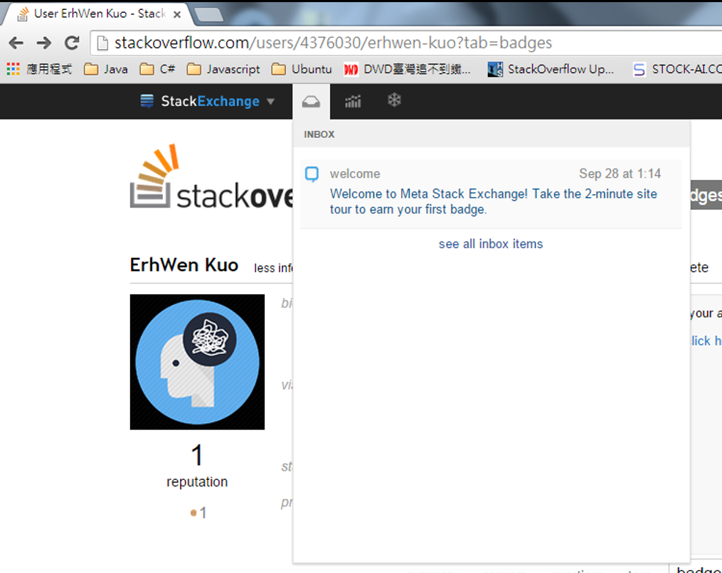
Architecture of stackoverflow
The UI has message inbox that is sent a message when you get a new badge, receive a message, significant event, etc. Done using WebSockets (SignalR) and is powered by redis (SignalR Redis Messaging Backplane )

Slide 15
Software Stack & Result
Marco Cecconi - "The Architecture of StackOverflow“
Youtube: https://www.youtube.com/watch?v=t6kM2EM6so4
Details Info: http://highscalability.com/blog/2014/7/21/stackoverflow-update-560m-pageviews-a-month-25-servers-and-i.html

Slide 16
Caching Strategy @ stackoverflow
Cache all the things
5 levels of caches
1st: is the network level cache: caching in the browser, CDN, and proxies
2nd: given for free by the .Net framework and is called the HttpRuntime.Cache. An in-memory, per server cache
3rd: Redis. Distributed in-memory key-value store. Share cache elements across different servers that serve the same site. If StackOverflow has 9 servers then all servers will be able to find the same cached items.
4th: SQL Server Cache. The entire database is cached in-memory
5th: SSD. Usually only hit when the SQL server cache is warming up

Slide 17

Redis Overview

Slide 18
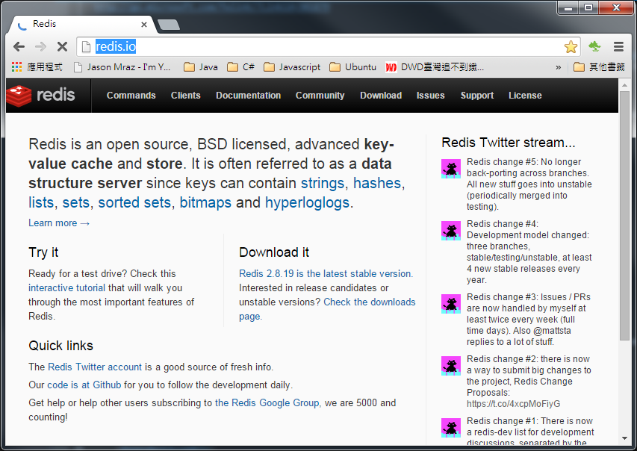
Redis Website
Http://redis.io/

Slide 19
What’s Redis
Redis is an open source, BSD licensed, advanced key-value cache and store.
It is often referred to as a data structure server, since keys can contain:
String
Hash
List
Set
Sorted Set
Bitmap
Hyperloglog

Slide 20
Installing Redis
Suggest runing Redis on Linux for PRD environment
Run Redis on Windows for DEV environment or Testing purpose

Slide 21
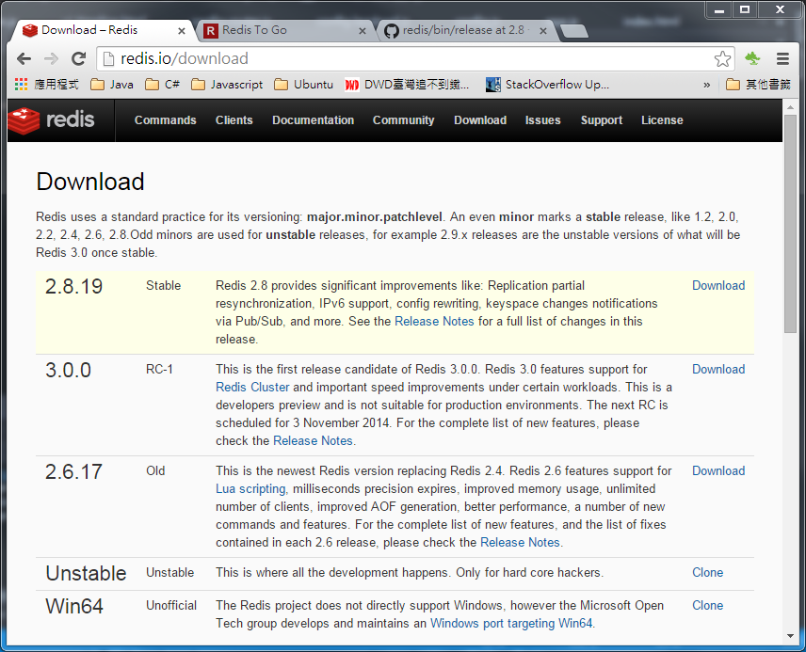
Download Redis

Slide 22
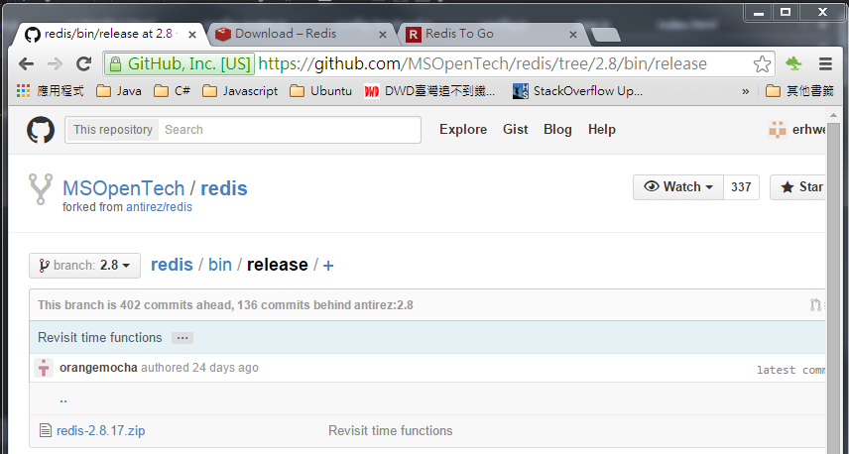
Download Redis
Get the latest Win64 release from Microsoft Github
https://github.com/MSOpenTech/redis/tree/2.8/bin/release
Download “redis-2.8.17.zip” and extract to specific folder

Slide 23
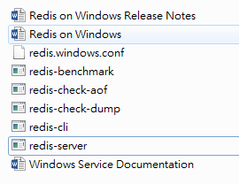
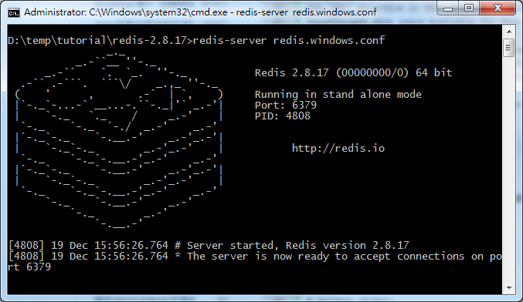
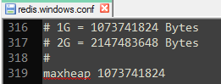
Run Redis Server
Used text editor to modify “redis.windows.conf”
Comment out “maxheap” and set the value to “1073741824(1GB)”
Open a Windows command console & type in:
“redis-server redis.windows.conf”
1
3
2

Slide 24
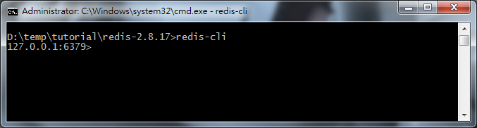
Using Redis Command Console Client
Open a Windows command console & type in:
“redis-cli”
1
2

Slide 25
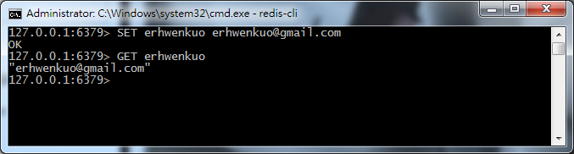
Redis Commands: Get & Set
Redis is a key-value store. By issuing the command “SET {key} {value}” you set the value of {value} to {key}.

Slide 26
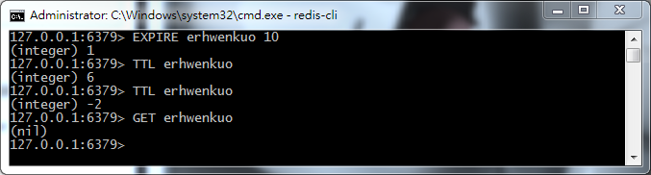
Redis Commands: Expire & Ttl
You can set keys to expire in a given amount of time by using the command, EXPIRE.
EXPIRE {key} {total_live_in_seconds}
TTL reports the time remaining before the key expires.
TTL {key}

Slide 27
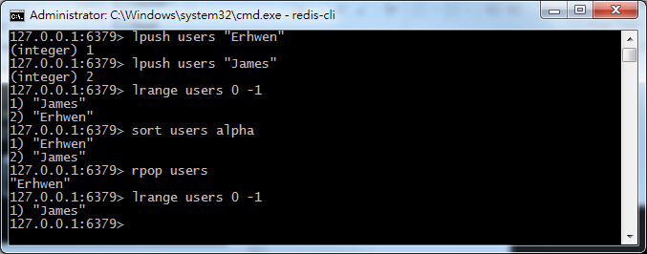
Redis Data Structure: List
One of the distinguishing features of Redis is that the values of a key can be data-structures, rather than just values
Following commands pertain to List:
RPUSH, LPUSH, LLEN, LRANGE, LTRIM, LINDEX, LSET, LREM, LPOP, RPOP, BLPOP, BRPOP, RPOPLPUSH & SORT

Slide 28
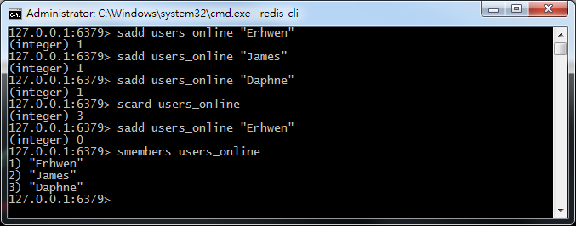
Redis Data Structure: Set
Set are similar to lists, except each element can occur only once.
Following commands pertain to Set:
SADD, SREM, SPOP, SMOVE, SCARD, SISMEMBER, SINTER, SINTERSTORE, SUNION, SUNIONSTORE, SDIFF, SDIFFSTORE, SMEMBERS, SRANDMEMBER

Slide 29
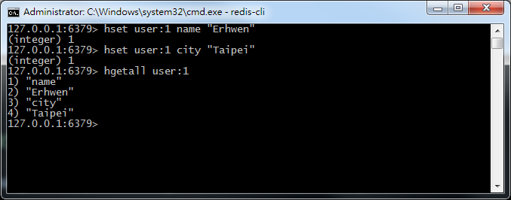
Redis Data Structure: Hash
Using a Hash, you can assign values to fields in each key.
Following commands pertain to Hash:
HSET, HGET, HSETNX, HMSET, HMGET, HINCRBY, HEXISTS, HDEL, HLEN, HKEYS, HVALS, HGETALL

Slide 30
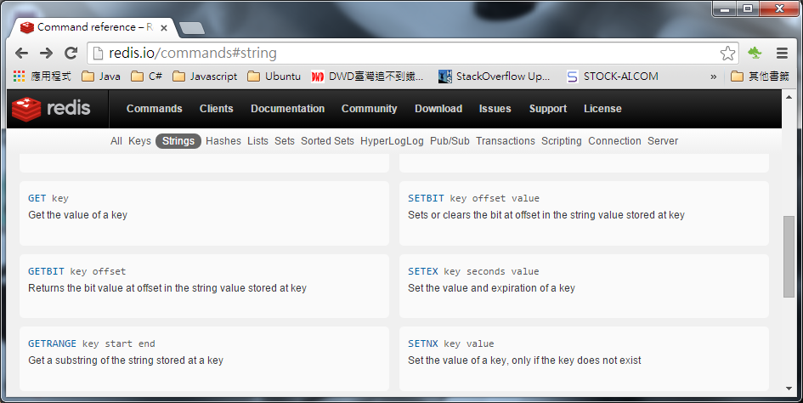
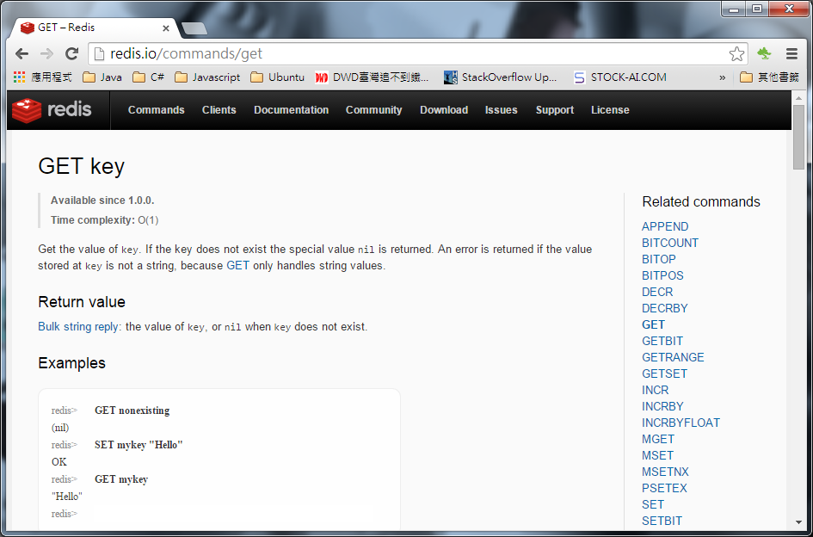
Redis Commands
Redis All Commands: http://redis.io/commands
Different data structures that Redis support
Redis command for specific data structure

Slide 31
Developing Asp.Net C# with Redis

Slide 32
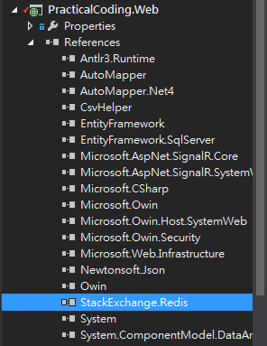
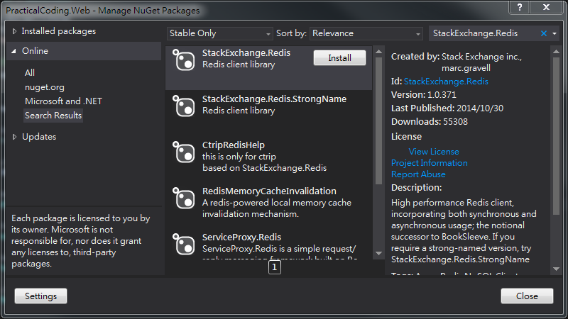
Environment Setup – Redis C# Client
Use NuGet to search “StackExchange.Redis” (C# redis client)
Click “Install”

Slide 33
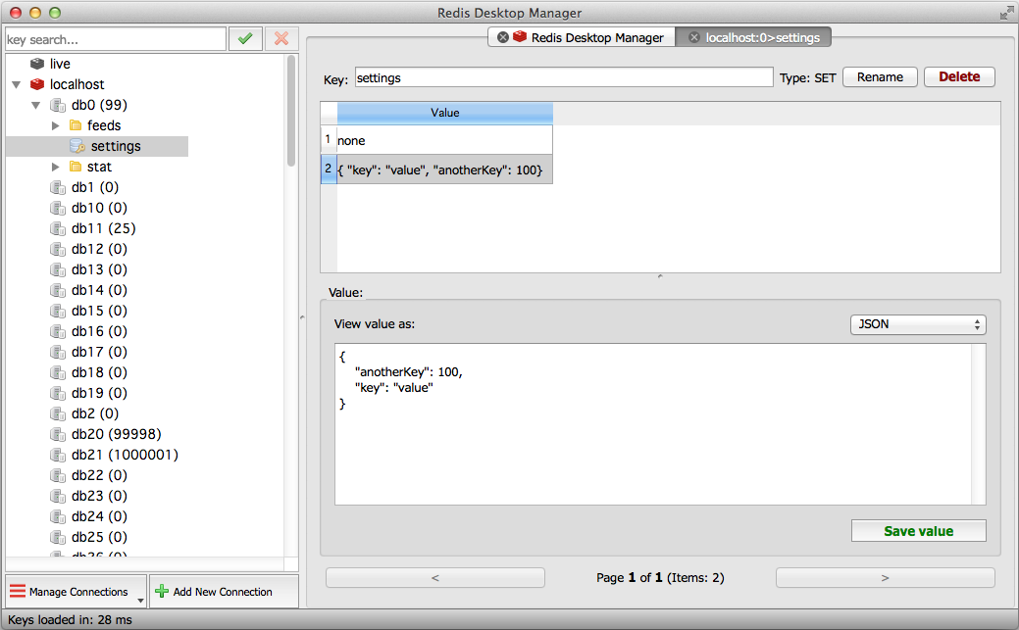
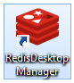
Environment Setup – Redis Desktop Manger
Download “Redis Desktop Manager”
https://github.com/uglide/RedisDesktopManager/releases/download/0.7.6/redis-desktop-manager-0.7.6.15.exe
Click “Install”

Slide 34
Redis in Practice#1 – WebApi Call Counts by Day
Potential for massive amounts of simple writes / reads
Valuable data, but not mission critical
Lots of row contention in SQL

Slide 35
Redis in Practice#1 – WebApi Call Counts by Day
What: Records Web API POST/PUT/GET/DELETE events
{Url: “/api/Employees” , Method: “post” }
When: Records When Web API events occurred
{EventDate: 2014/12/22 10:00:00}
Where: Records Which Web API Provider
{Host: “server01”}

Slide 36
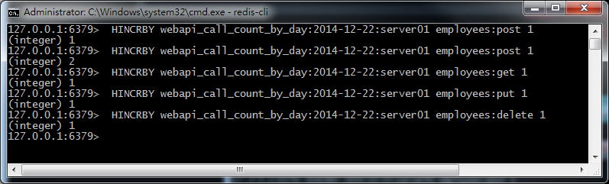
Redis in Practice#1 – WebApi Call Counts by Day
Redis: Hash data structure:
Something we want to know (Counter)
{MetricName}:{When}:{Where}
{What}
webapi_call_count_by_day:yyyy-mm-dd:server01
employees:post
1024
Key
HashKey
HashValue

Slide 37
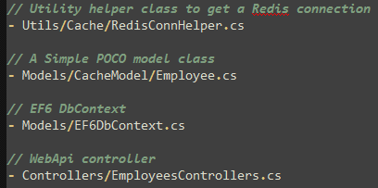
Redis in Practice#1 – WebApi Call Counts by Day
Create a new C# class “RedisConnHelper.cs” to get redis connection object
Create a new C# POCO class “Employee.cs” as domain model entity
Modify “EF6DbContext.cs” include EF6 ORM support for “Employee.cs”
Execute “Add-Migration AddEmployee” and “Update-Database” in “Package Manager Console”
Add new web api controller named “EmployeesControllers.cs”

Slide 38
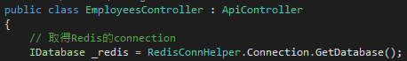
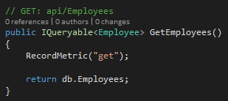
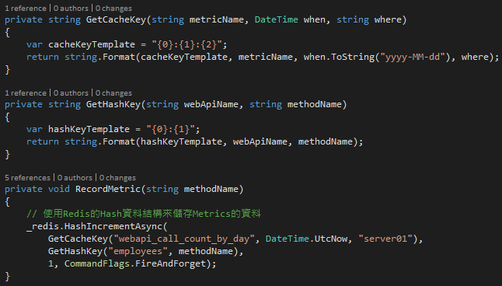
Redis in Practice#1 – WebApi Call Counts by Day (EmployeesController)

Slide 39
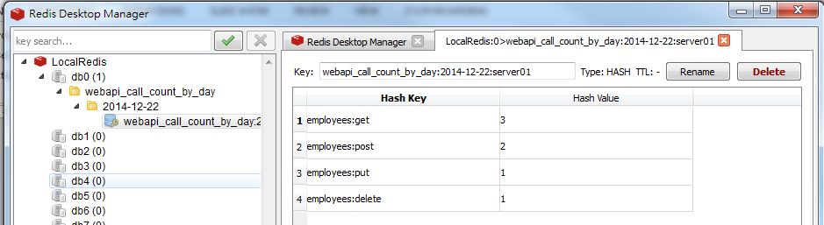
Redis in Practice#1 – WebApi Call Counts by Day
Demo
Hit “F5” to run “PracticalCoding.Web”
Use “Fiddler2” to test below Web APIs (“/api/Employees”)
Use “Redis Desktop Manger” to see the Metric result

Slide 40
Redis in Practice#2 – Realtime Metrics
Traditionally, metrics are performed by a batch job (running hourly, daily, etc.)
Redis backed bitmaps allow us to perform such calculations in realtime and are extremely space efficient.

Slide 41
Crash Course on Bitmap and Redis Bitmaps
The setbit(key, offset, value) operation, which takes O(1) time, sets the value of a bit to 0 or 1 at the specified offset for a given key.
Bitmap (aka Bitset)
A Bitmap or bitset is an array of zeros and ones.
A bit in a bitset can be set to either 0 or 1
Eeach position in the array is referred to as an offset
Redis support Bit Operations such as logical AND, OR, XOR & NOT
Bitmaps in Redis
Redis allows binary keys and binary values
The setbit(key, offset, value) operation, which takes O(1) time, sets the value of a bit to 0 or 1 at the specified offset for a given key.

Slide 42
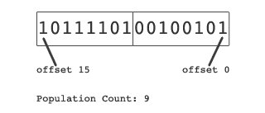
Population Count
The setbit(key, offset, value) operation, which takes O(1) time, sets the value of a bit to 0 or 1 at the specified offset for a given key.
The population count of a Bitmap is the total number of bits set to 1.

Slide 43
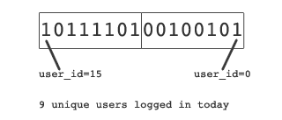
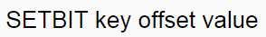
A Simple Example: Daily Active Users
The setbit(key, offset, value) operation, which takes O(1) time, sets the value of a bit to 0 or 1 at the specified offset for a given key.
Purpose: To count unique users that logged in today
HowTo:
We set up a bitmap where each user is identified by an offset value
When a user visits a page or performs an action, which warrants it to be counted, set the bit to 1 at the offset representing user id
The key for the bitmap is a function of the name of the action user performed and the timestamp
Every time a user logs in we perform:
redis.setbit(daily_active_users, user_id, 1)

Slide 44
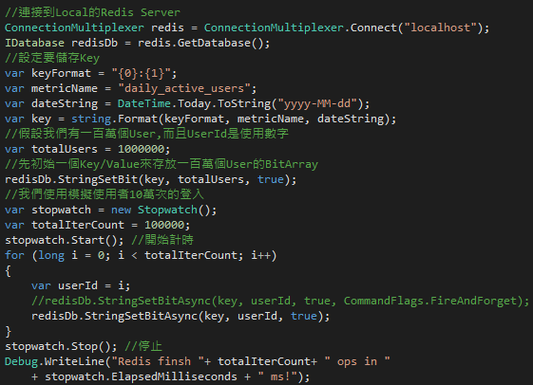
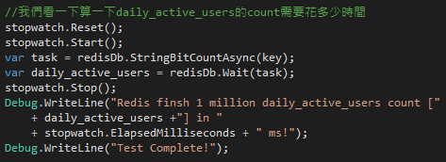
A Simple Example: Daily Active Users (Session_05_UnitTest.Bitmap_Test.cs)
The setbit(key, offset, value) operation, which takes O(1) time, sets the value of a bit to 0 or 1 at the specified offset for a given key.

Slide 45
A Simple Example: Daily Active Users (Session_05_UnitTest.Bitmap_Test.cs)
The setbit(key, offset, value) operation, which takes O(1) time, sets the value of a bit to 0 or 1 at the specified offset for a given key.
Demo
In my laptop, it can reach
around 400K op/s through put!!
The BitCount is very space efficient and also the speed is fast!!

Slide 46
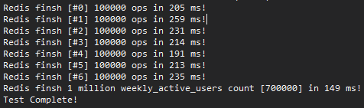
A Simple Example: Daily Active Users (Session_05_UnitTest.Bitmap_Test.cs)
The setbit(key, offset, value) operation, which takes O(1) time, sets the value of a bit to 0 or 1 at the specified offset for a given key.
Demo
In my laptop, it can reach
around 400K op/s through put!!
The BitCount is very space efficient and also the speed is fast!!

Slide 47
Redis in Practice#3 – Redis as Datastore
“Memory is the new disk, disk is the new tape” – Jim Gray
Twitter Uses Redis To Scale - 105TB RAM, 39MM QPS, 10,000+ Instances
http://highscalability.com/blog/2014/9/8/how-twitter-uses-redis-to-scale-105tb-ram-39mm-qps-10000-ins.html

Slide 48
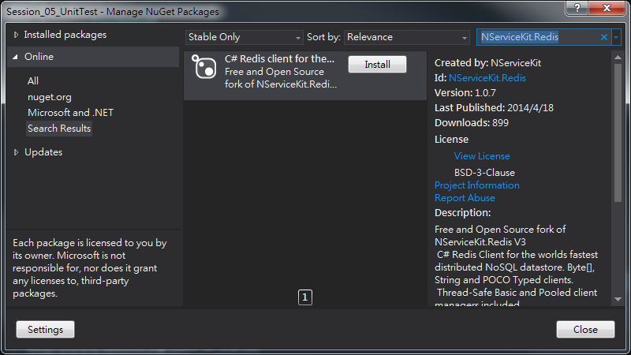
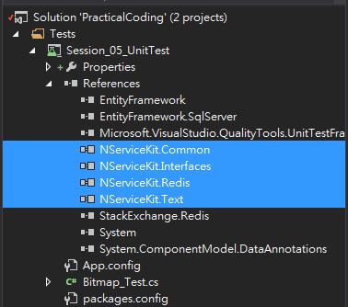
Environment Setup
Use NuGet to search “NServiceKit.Redis”
Click “Install”

Slide 49
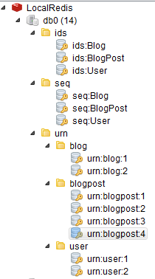
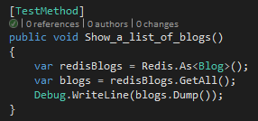
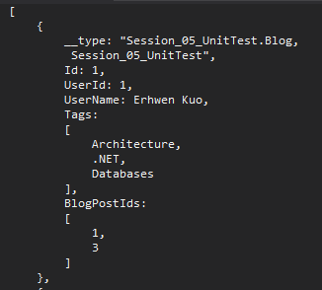
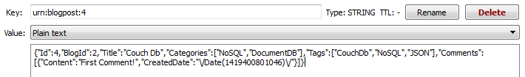
A Simple Example: Daily Active Users (Session_05_UnitTest. Datastore_Test.cs)
The setbit(key, offset, value) operation, which takes O(1) time, sets the value of a bit to 0 or 1 at the specified offset for a given key.
Demo

Slide 50
Highchart , AngularJS ,Web API2 , SignalR2 , EF6 + Redis Integration

Slide 51
Integration with Entity Framework
Copy “09_IntegrationWithEF6” to “10_IntegrationWithRedis ”

Slide 52
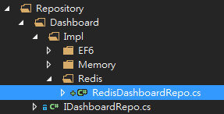
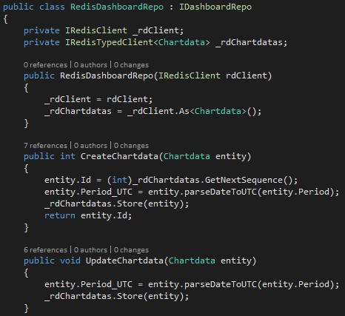

Create New RedisDashboardRepo.cs

Slide 53


Initial Chartdatas (Global.asax.cs)

Slide 54


Switch “EF6DashboardRepo” to “RedisDashboardRepo”
Copy “EF6DashboardController.cs” to “RedisDashboardController.cs”
Dispose “RedisClient” connection object to release redis client connection
Switch our Repository from “EF6” to “redis”

Slide 55


Modify Our Angular “ChartDataFactory”
Switch angular $http communication end point to our new WebAPI url
Before
After

Slide 56



Integration with Redis
Demo
Select “10_Integration/index.html” and Hit “F5” to run
Open Multi-Browers to see charts reflect changes whenever C/U/D operations occurred

Slide 57


Next Session: AngularJS , Highchart , Asp.Net WebApi2 , SignalR2 , EF6 , Redis + Elasticsearch

